Slide 1
CYBER GYAN VIRTUAL INTERNSHIP PROGRAM Centre for Development of Advanced Computing (CDAC), Noida
Submitted By:
RAHUL KUMAR SINHA
Project Trainee, (July-August) 2025
BIT SINDRI, DHANBAD(INFORMATION TECHNOLOGY)

Slide 2
TOPIC NAME
PROJECT DEALS WITH THE TOPIC:
Analysing Phishing Techniques That Bypass Spam Detection System and Techniques

Slide 3
PROBLEM STATEMENT
This project investigates how phishing attacks evade spam detection filters. we'll analyze common techniques used by phishers, explore spam detection methods' limitations, and identify potential improvements for more robust email security.

Slide 4
TECHNOLOGY/TOOLS TO BE USED
The various technology/Tools used for this project completion are as follows:-
1.Spam Assassin : Popular open-source spam-filtering software.
2.Open Web Application Security Project Zed Attack Proxy (OWASP ZAP) : Popular open source tool used for web security testing.
3.Phishing Tank: Stores the data of phishing and spam links and is also used for checking the phishing site.
4. UCI Machine Learning Repository: Contains Phishing Email Dataset.

Slide 5
PROBLEM STATEMENT
Phishing remains a persistent threat, employing sophisticated tools and techniques to evade detection. While technology provides various protective measures — such as email filters, website authentication (like SSL/TLS), and multi-factor authentication — criminals continually adapt to bypass these defenses through domain spoofing, obfuscation, and social engineering.

Slide 6
WHAT ARE THE REASONS BEHIND THE PROBLEM
The success of bypassing spam detection systems is mainly due to the attackers’ ability to adapt, obfuscate, and personalize their methods, exploiting limitations within existing detection technologies. An effective defense combines advanced detection algorithms, continuous updates, and ongoing user education.

Slide 7
COUNTERMEASURES
Whitelist Trusted Domains .
Sandbox Untrusted Messages.
Blackholing Untrusted Messages.
Implement multi-layered defences.
User education:
Incident response plans.
Be cautious with emails and messages.

Slide 8
Implementation of Techniques
1.Spam Assassin : Popular open-source spam-filtering software.
2.Open Web Application Security Project Zed Attack Proxy (OWASP ZAP) : Popular open source tool used for web security testing.
3.Phishing Tank: Stores the data of phishing and spam links and is also used for checking the phishing site.
4.Anti-Phishing Working Group (APWG): Non-profit organization which is dedicated for combating phishing.

Slide 9
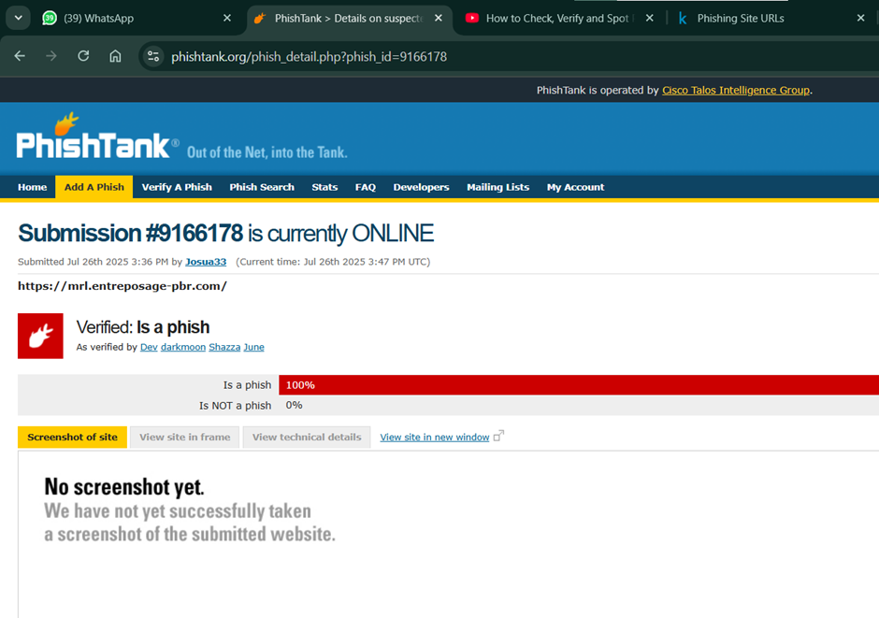
Phishing Tank

Slide 10
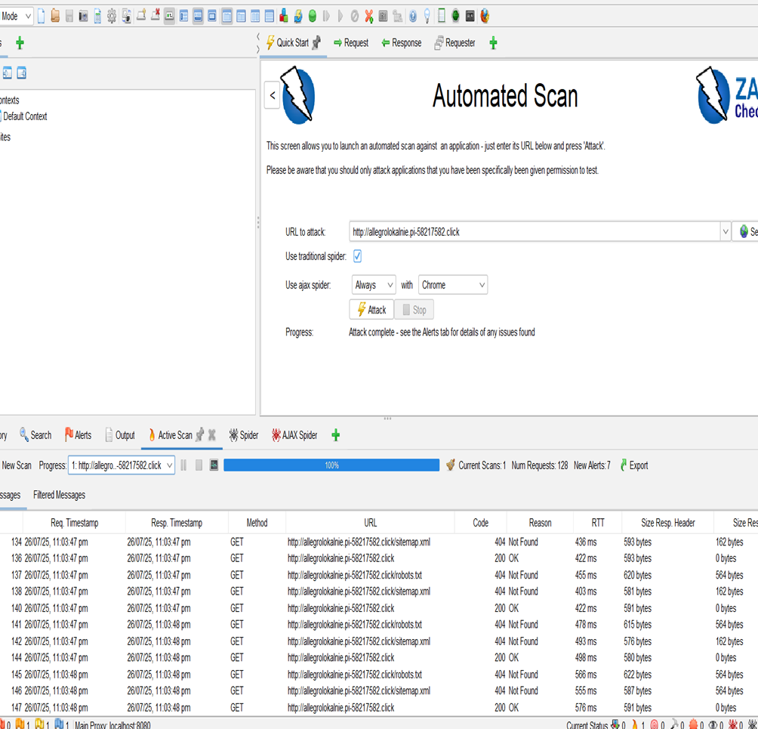
OWASP ZAP

Slide 11
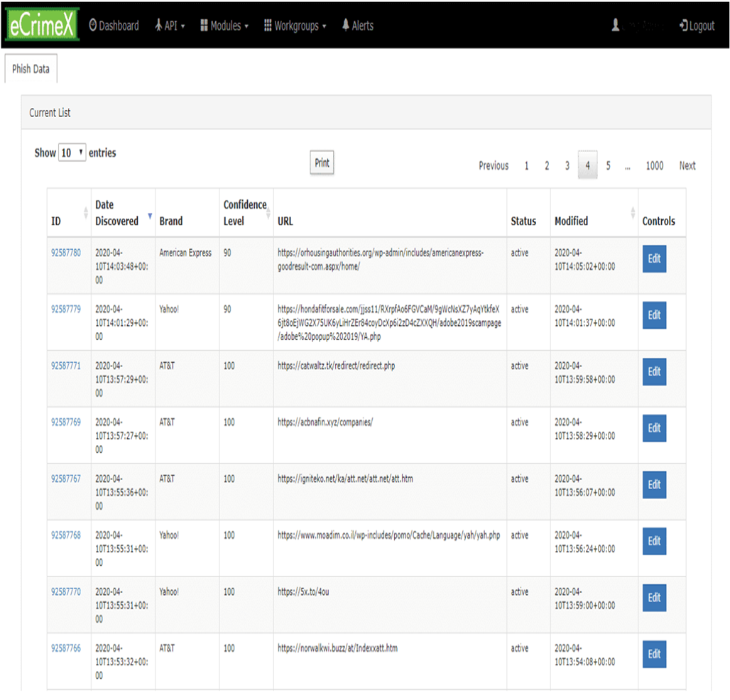
APWG

Slide 12
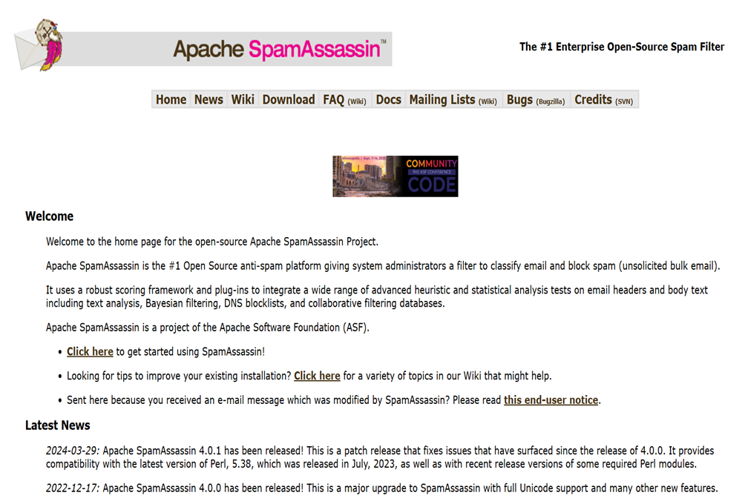
SPAM ASSAIN

Slide 13
BEST PRACTICES TO AVOID ATTACKS
Constantly update filter rules and signatures: Cybercriminal tactics evolve rapidly. Regular updates ensure your filters recognize new attack vectors.
Implement multi-layered defences: Combine spam filtering with URL filtering, malware scanners, and behavioural analysis for comprehensive protection.
User education: Train users to recognize and report phishing emails, reinforcing technical defences.
Incident response plans: Prepare to quickly respond to detected attacks and inform stakeholders.

Slide 14
SUMMARY
An effective defence against the attack requires a combination of technological solutions, user education, and vigilant monitoring.
Continued research and proactive security practices are essential to mitigate the evolving landscape of phishing attacks.
By configuring your email security infrastructure to be as tight as operationally feasible—whitelisting trusted domains, sandboxing all others, and blackholing untrusted messages—you significantly reduce the chances of malicious emails reaching end-users
This approach, combined with ongoing update practices and user training, creates a resilient defence against evolving phishing threats.

Slide 15
THANKYOU !!

